Slide 1
Predicting Parkinson With Handwriting

Slide 2
What's new / Goals
Exploration into unique variables
Data Segmentation
Unique variable testing
Found other data to use for segmentation

Slide 3
Unique Variables
Using the Z axis height can be determined as well as how many times the pen was taken off the paper
Using Grip Angle can be used to help determine the strength of the patients

Slide 4
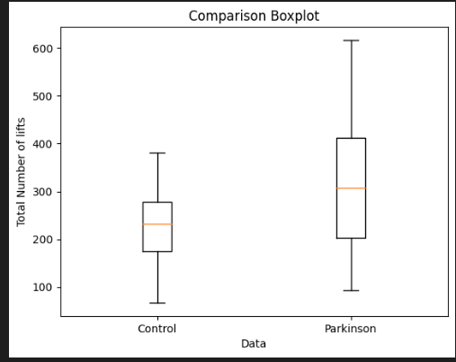
Pen Lifting
The hypothesis for this variable is that because
Parkinson affects patients strength the number of
Times the Parkinsons patients take the pen off the
Paper will be increased

Slide 5
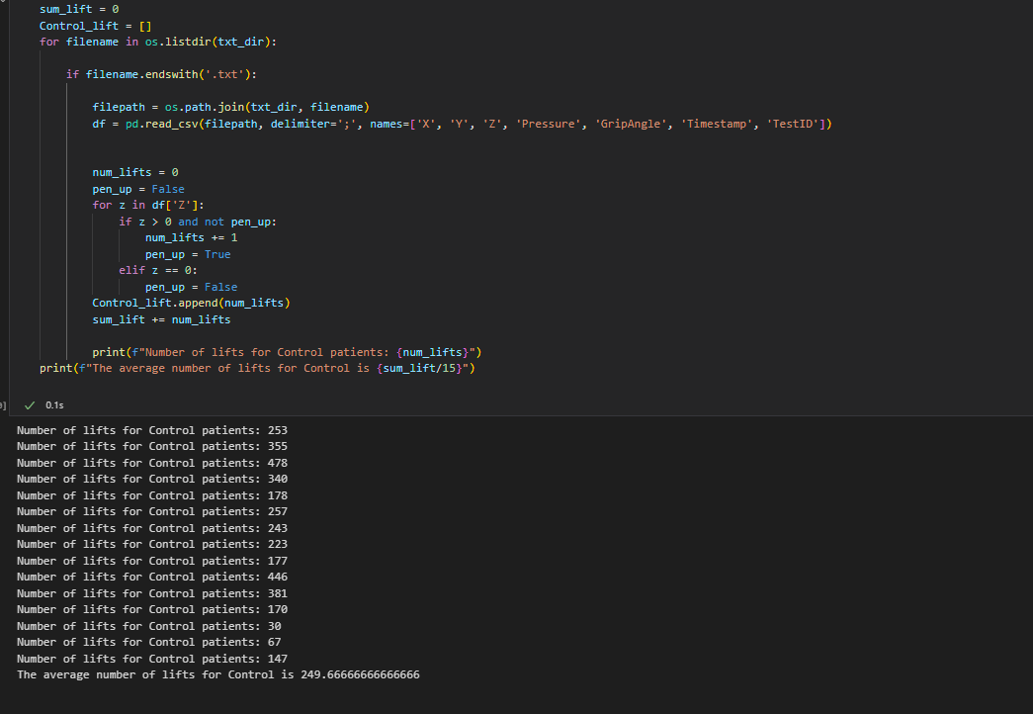
The Average number for
Control was 249 lifts off the
paper

Slide 6
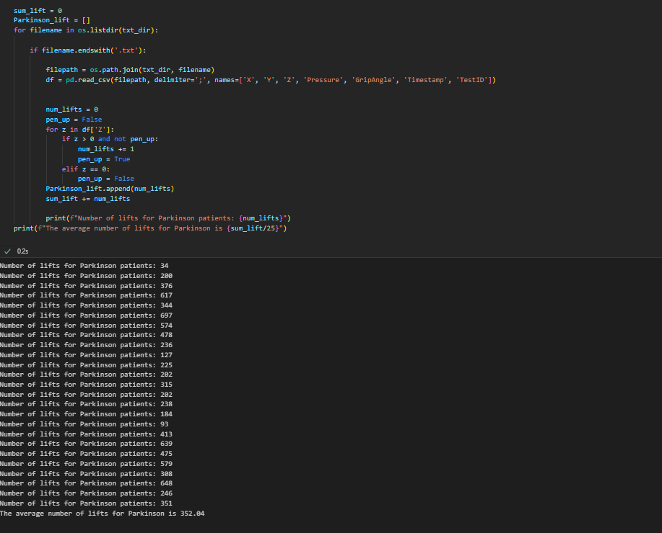
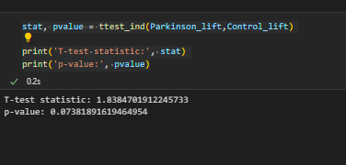
The Average number for
Parkinson patients was 352 lifts off the
paper

Slide 7
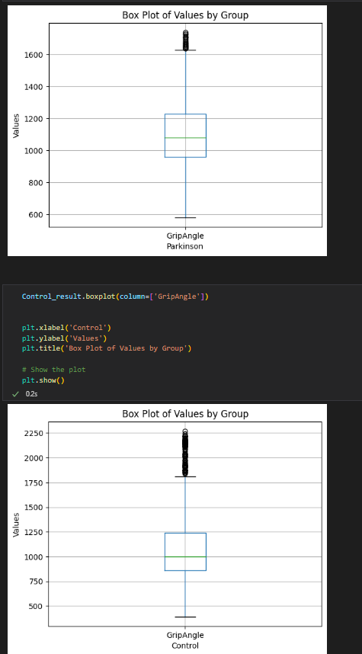
Grip Angle
Using the Grip Angle is another determinant that has been proven in past studies to have a relation but hasn’t been used for prediction using Machine Learning

Slide 8
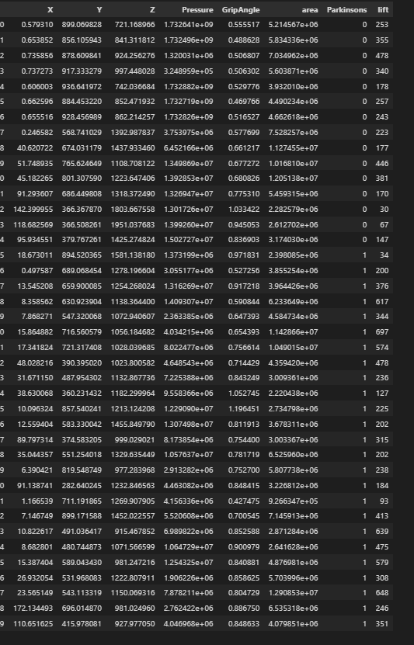
Segmentation
Currently the segmentation is based off the extracted variables
Later on I would like to add other data to better Segment
Such as data on age and gender

Slide 9
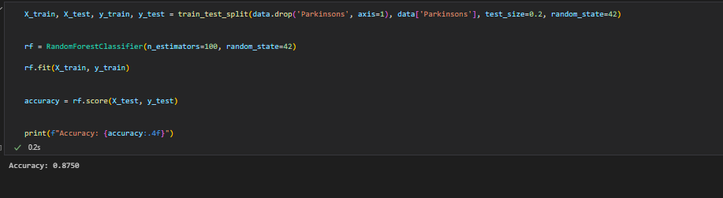
Random Forest
After adding the lift column into the data frame
I was able to use Random Forest to help predict with
87.5% accuracy

Slide 10
Goals
For next week I would like to have more data segmented
I would also like to work on clustering to help with classification

